Slide 1
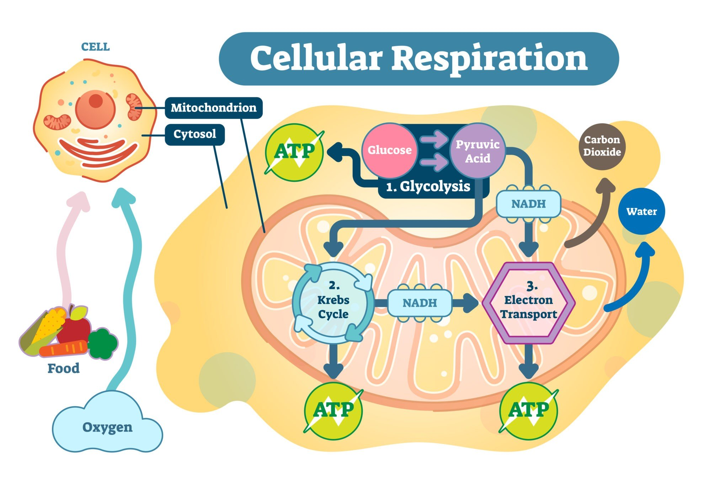
Respiration
Key Stage 4 Science

Slide 2
Important!
In Biology RESPIRATION IS NOT THE SAME AS BREATHING.
BEWARE! These terms are often confused!!

Slide 3
Breathing
Happens in the lungs.
We breathe in (inhale) oxygen.
We breathe out (exhale) carbon dioxide.
This is called gas exchange.

Slide 4
Respiration
Happens in every cell in the body.
Is a chemical reaction.
Releases energy from food.
Most respiration uses oxygen and produces carbon dioxide.
This is called aerobic respiration.

Slide 5
The Equation
Glucose + Oxygen → Carbon dioxide + Water
C₆H₁₂O₆ + O₂ → CO₂ + H₂O
This equation is not balanced.
There are 6 carbons on the left and only 1 on the right.
There are 12 hydrogens on the left and only 2 on the right.
There are 8 oxygens on the left but only 3 on the right.

Slide 6
Balancing the Equation
Glucose + Oxygen → Carbon dioxide + Water
C₆H₁₂O₆ + 6O₂ → 6CO₂ + 6H₂O
This equation is balanced.
There are 6 carbons on each side.
There are 12 hydrogens on each side.
There are 18 oxygens on each side.

Slide 7
Glucose
Is a simple sugar.
We get it from our food.
There are other types of sugar e.g. fructose and sucrose.
Carbohydrates like starch are broken down by digestion to produce glucose.
When glucose reacts with oxygen energy is released.

Slide 8
Oxygen
Comes from our lungs.
It is carried around the body by red blood cells.
Arteries carry oxygen rich blood to all parts of the body.
Tiny blood vessels called capillaries carry the oxygen to the cells.

Slide 9
Carbon Dioxide
Is produced by respiration.
Is not useful for our bodies.
Too much carbon dioxide can kill us.
Blood carries carbon dioxide back to the lungs.
We breathe it out – exhale.

Slide 10
Water
Our bodies contain a lot of water.
But too much water would be a problem.
Our cells could burst like balloons.
We get rid of some water when we breathe out.
Test this by breathing on a window. You can see the water condense.
We also get rid of extra water when we urinate (wee).

Slide 11
Mitochondria
The mitochondria is “the powerhouse” of the cell.
The part of the cell that does respiration.
Mitochondria are organelles (like mini organs inside cells).
They are often too small to see when we look at cells under the microscope.

Slide 12
Anaerobic Respiration
Another way to release energy.
Happens when your cells do not have enough oxygen e.g. when you have been running a long way.
Creates lactic acid from glucose.
Lactic acid builds up in your muscles after a lot of exercise.
It makes them tired and achy.

Slide 13
Activities
Complete one of the worksheets.
Visit https://www.bbc.co.uk/bitesize/guides/zp4mk2p/revision/1
Feel you normal pulse rate. Count how many beats per minute. Do some exercise then count how many beats per minute.
Look at food packaging. Find out how much energy is in the food. Compare different foods. What kinds of foods have the most energy?
Do some exercise that works all your muscles, like running or dancing, how do you feel after you exercise? What changes have happened in your body?
Make a quiz about respiration. Test your mum, dad, brother or sister.

