Slide 1
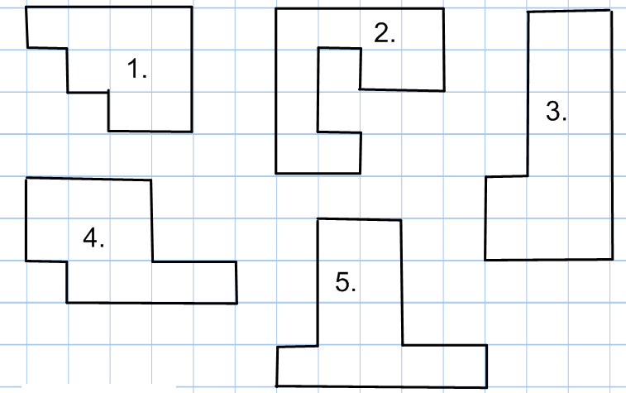
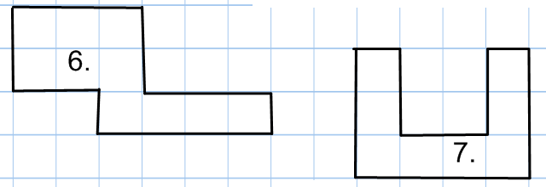
Calculate the perimeter of the following shapes
TASK A:
TASK B:
4 cm
23 m
9.4 cm
7 cm
20 m
13 m
1.9 cm
A
B
C
5 cm
15 m
3.1 cm
7.8 cm
10 cm
7 m
5.9 cm
3 cm
9 cm
8 m
6.3 cm
124 mm
14 m
12 cm
90 mm
E
2.4 m
7 cm
D
12 m
F
181mm
88 mm
3.7 m
18 cm
x cm
91mm
9.6 m
11 cm
212 mm
10.3 m
20 cm
What is the value of x ?

Slide 2
Find the missing side and calculate the perimeter
3 cm
9 cm
1800 cm
8 cm
18 m
A
7 cm
5 cm
B
220mm
C
5 cm
13 cm
10 m
12 m
10 cm
15 cm
8 m
1.5 cm
9 mm
13 cm
1 cm
10 cm
D
1.4 cm
E
F
0.35m
2.2 cm
8mm
3.2 cm
20 mm
8 cm
20 cm
I
Mr Jones is a chicken farmer.
12 m
y m
G
30 cm
12m
chicken enclosure
5 m
x cm
x cm
H
y m
8 m
12 cm
6 m
y m
50 cm
15m
He wants to build a new fence
around the chicken enclosure.
Each meter of fencing will cost £7.99
Work out the cost of the new fence.
12 cm
a cm
a cm
K
Write an expression for the perimeter of the shape.
26 cm
x
40 cm
a cm
a cm
a cm
a cm
x + 8
J
Both shapes have the same perimeter.
Find the value of a.
x + 1
x + 10

Slide 3
Calculate the perimeter (Show your working out in your book)
5 cm
2.5 m
8 cm
5 cm
7 cm
A
B
220 mm
180 cm
C
15 cm
5 cm
1.2 m
20 cm
120 cm
3.7 cm
4x + 3
Find the missing side and
Write an expression for the perimeter
D
E
12.7 cm
4.9 cm
5x + 8
6x + 2
8.4 cm
3x + 2
10x + 5
Extension Task : Calculate the missing sides
3.4 cm
6 cm
A
10 cm
Perimeter = 90cm
C
8 cm
5 cm
B
20 cm
Perimeter = 30.6 cm
6.7 cm
Perimeter = 46cm
5 cm
5.2 cm
3x + 15
5x - 2
Find the value of x
Perimeter = 52m
Perimeter = 70m
x - 2
E
2x - 5
D
7x + 4
4x - 1
2x + 7
3x - 2

