Slide 1
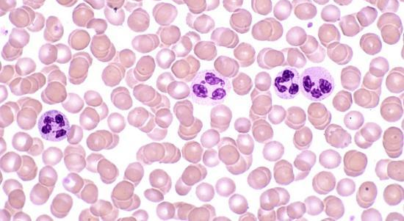
Cells
Key Stage 4 Science
Entry Level and GCSE

Slide 2
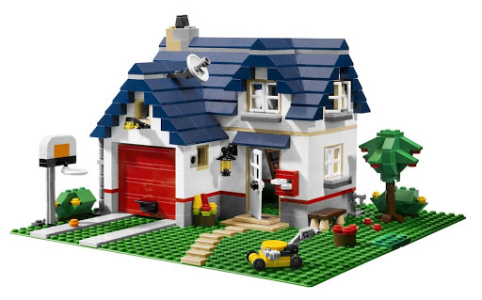
Cells – Building Blocks of Life
All living things are made of cells.
There are many different kinds of cells.
They are a bit like building blocks.
A Lego model is made of lots of different types of Lego brick.
A living thing is made of lots of different types of cell.

Slide 3
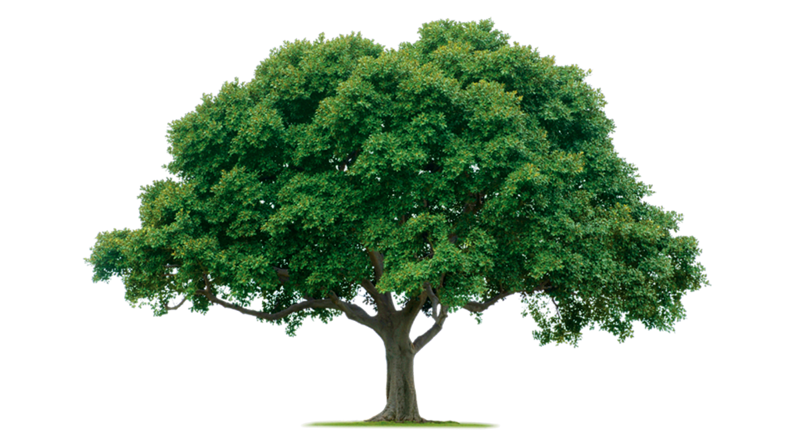
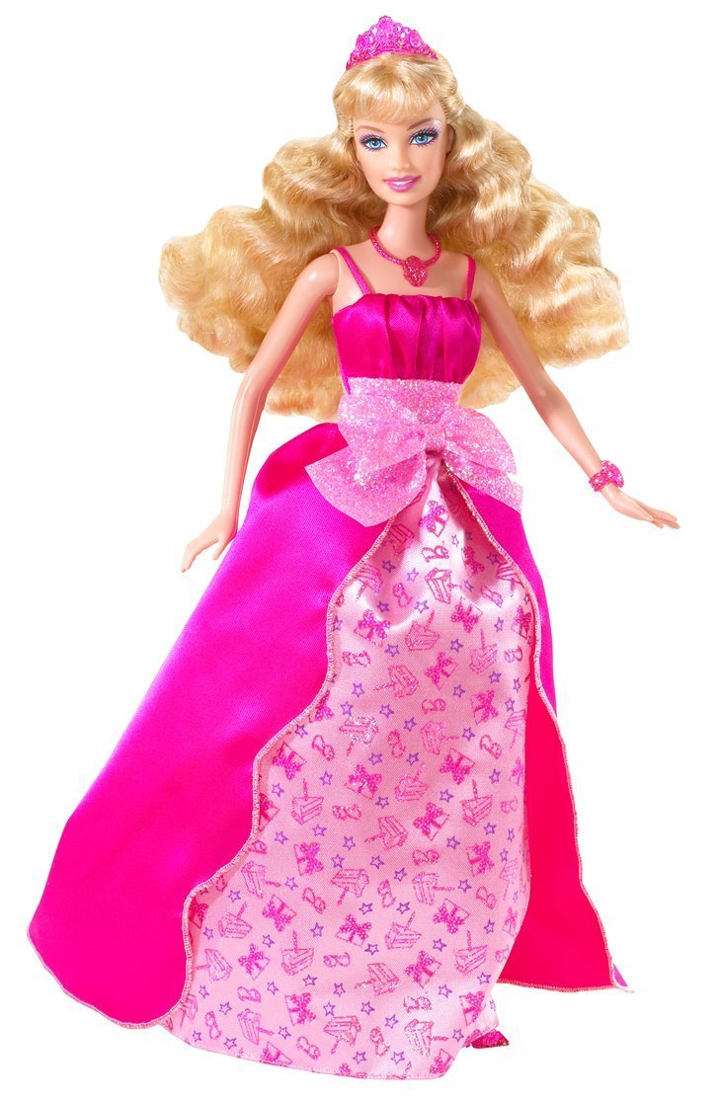
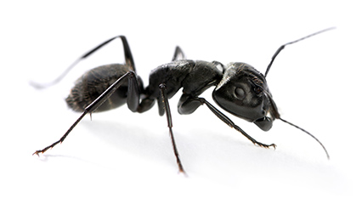
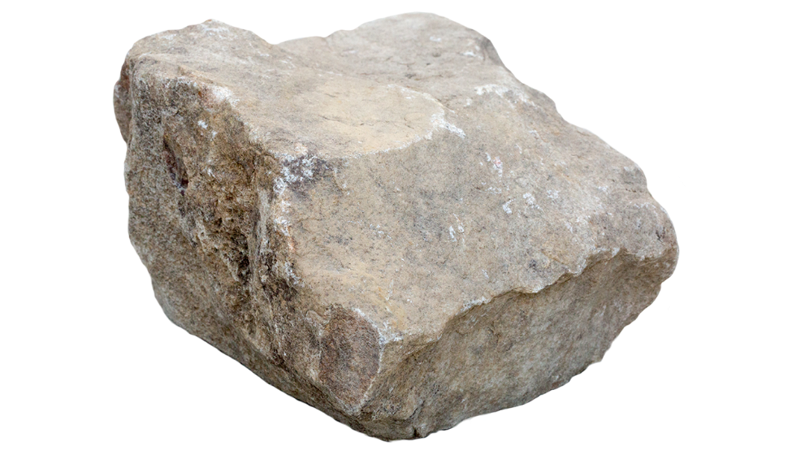
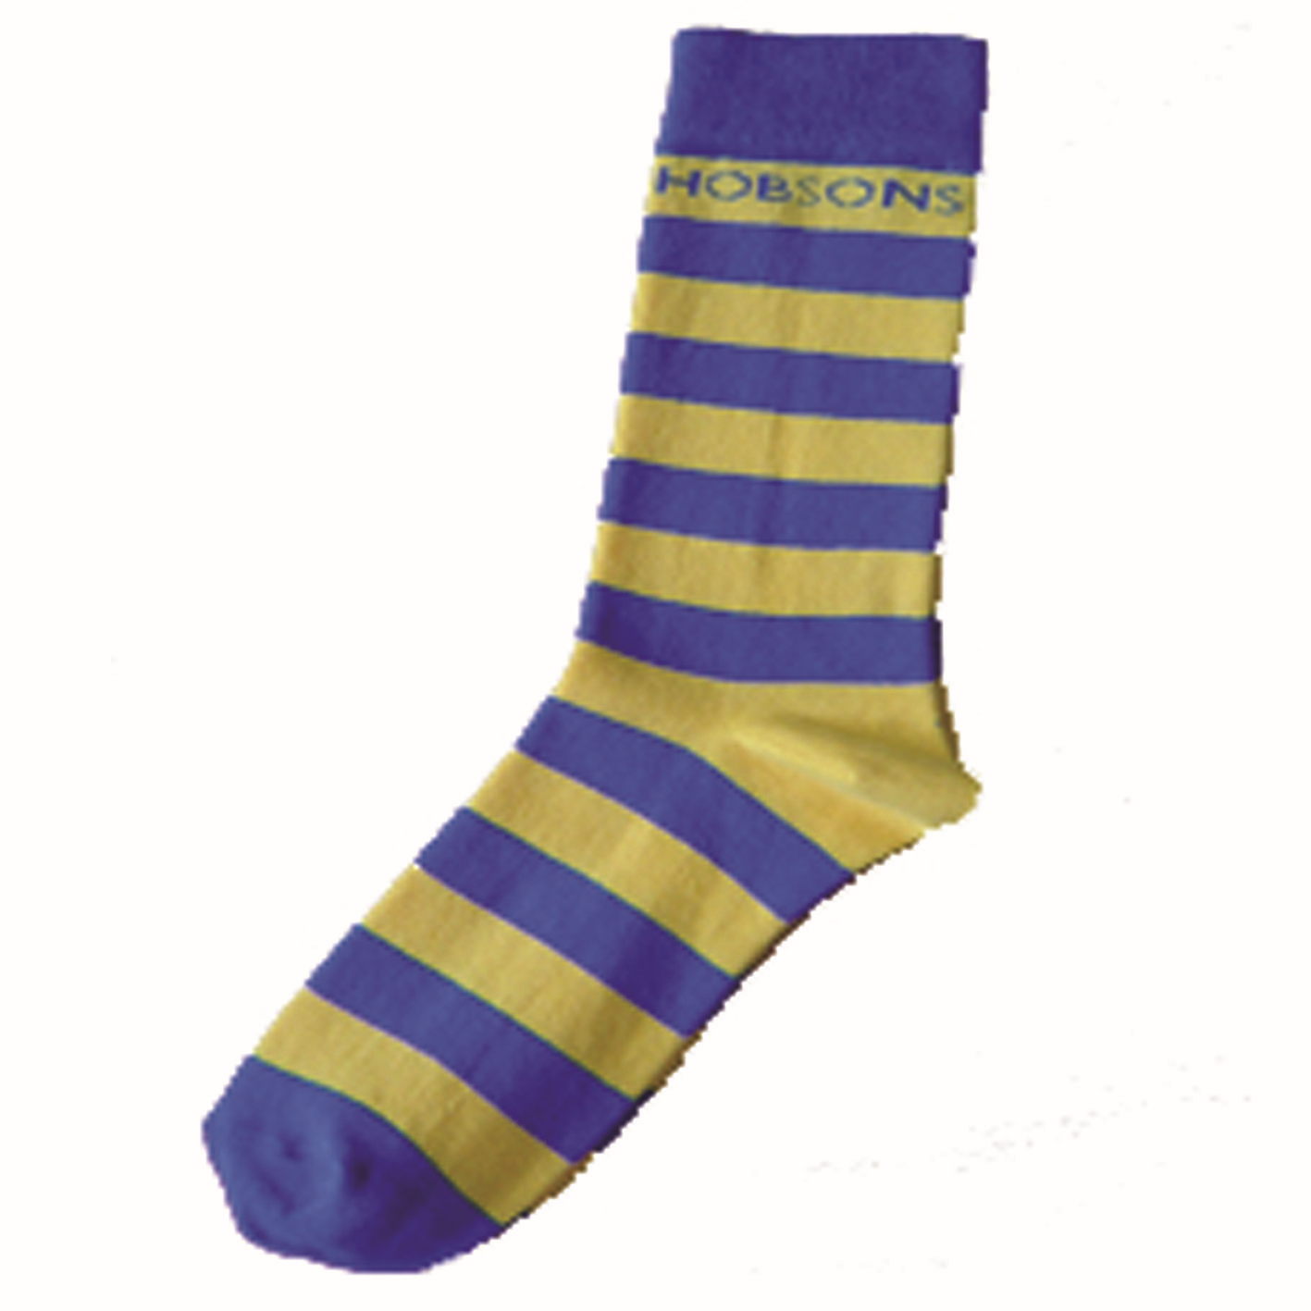
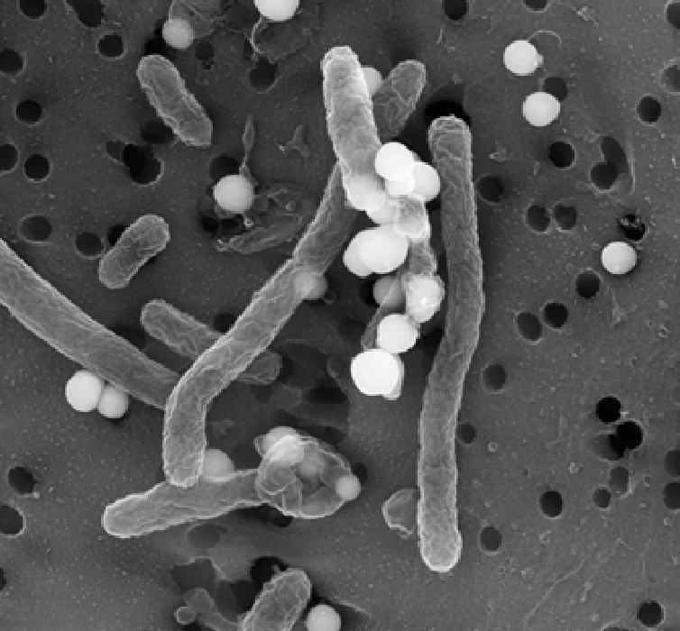
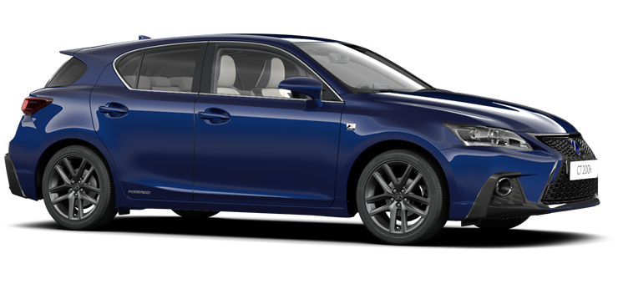
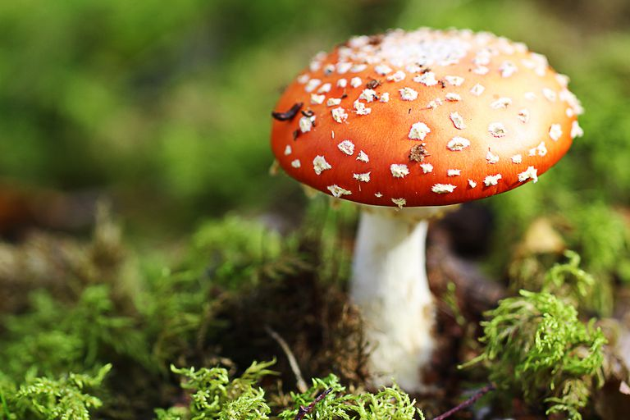
Which of these are made of cells?

Slide 4
Microbes
Some organisms (living things) have only one cell.
These are tiny things like bacteria, algae and some fungi.
We call these microorganisms or microbes for short.
Micro means very, very small.

Slide 5
Animal Cells
Ribosome
Nucleus
Cell membrane
Mitochondria
Cytoplasm

Slide 6
Animal Cells
Usually irregular, rounded shapes.
The nucleus is the control centre of the cell.
The cell membrane is like a skin around the cell. It allows substances in and out of the cell.
The cytoplasm is a jelly like substance inside the cell.
The mitochondria release energy from food.
Ribosomes make proteins.

Slide 7
Animal Cells under a Microscope

Slide 8
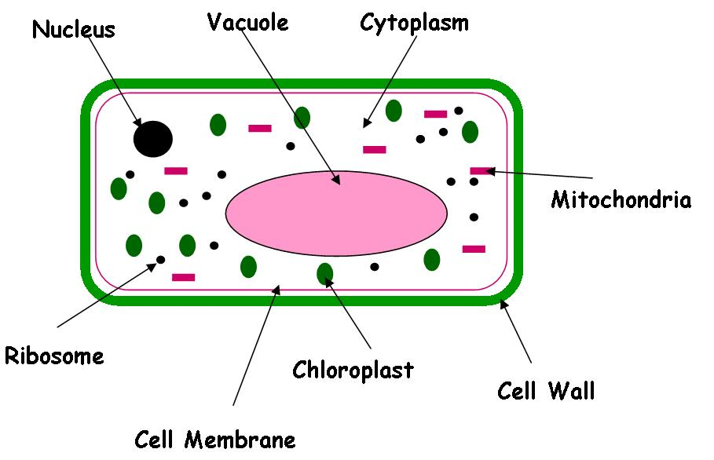
Plant Cells

Slide 9
Plant Cells
Plant cells have more regular shapes with straight edges.
The have a rigid cell wall around them to give them strength.
They have chloroplasts for photosynthesis (making their own food).
They have a space in the middle to store water called the vacuole.

Slide 10
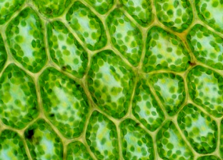
Plant Cells under a Microscope.

Slide 11
Looking at Cells
Most cells are too small to see with our eyes.
But we can see cells if we use a microscope.
We put the cells on a small piece of glass called a slide.
We cover with another piece called a cover slip.
We place the slide on the microscope stage and hold it in place with the clips.

Slide 12
Looking at Cells
We always use the smallest magnification first as it is easier to focus.
Use the coarse focus first then the fine focus.
Be careful not to get the sample too close to the lens as you could damage the microscope or break the slide.

Slide 13
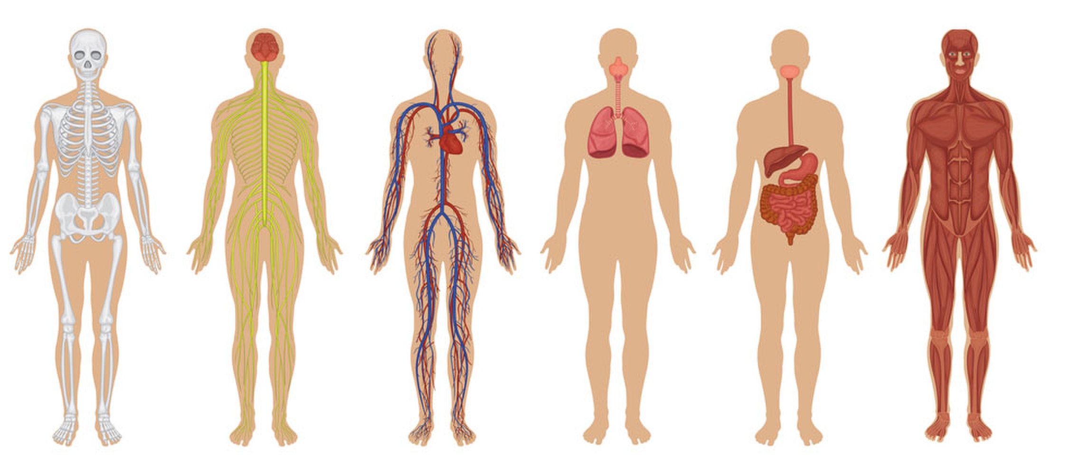
The human body contains 30-40 TRILLION Cells!
30 000 000 000 000 cells!

Slide 14
More Activities
Look up pictures of plant and animal cells online. Try drawing them. Label the features you can see.
Make jelly cells. Make some jelly, this is the cytoplasm. Put some different size and shaped sweets into a bowl or container to represent the different parts of the cell. Pour in the jelly and leave it to set in the fridge. Take a photo of your jelly cell before you eat it!
Visit https://www.bbc.co.uk/bitesize/guides/zpqpqhv/revision/1

